Slide 1
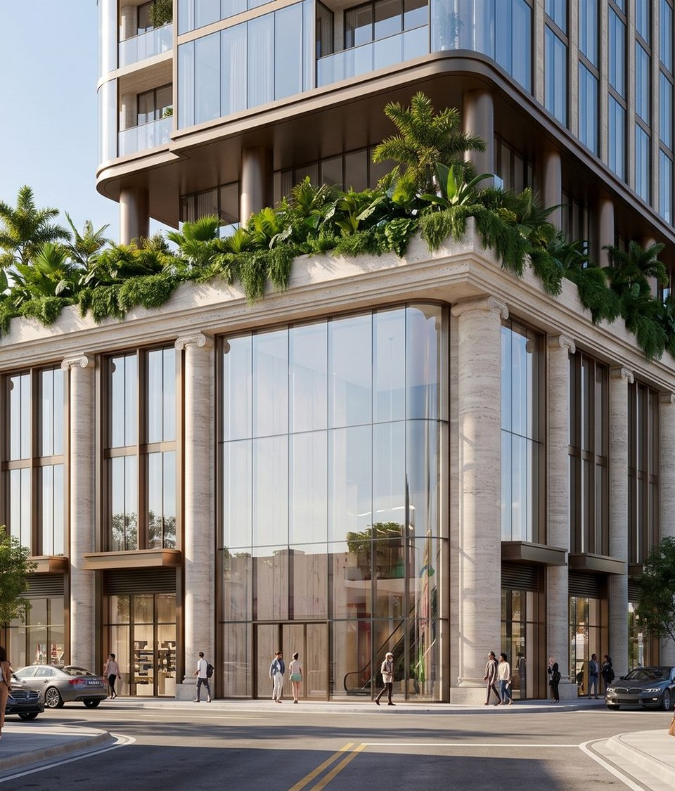

A WELLNESS FRANCHISE GROUP COMPANY
RegenHealth
Physicians
Physician-Led Regenerative Medicine & Longevity Platform
Confidential Investor Presentation · April 2026
James Zimbler, CEO · Dr. Ajit Dhaliwal, MD — CMO · Vincent Butta, COO
$3.25M
$10M
20%
2
50+
SAFE Raise — 506(b)
Pre-Money Val.
SAFE Discount
Live Locations
5-Year Target

Slide 2
LEGAL NOTICE
Disclaimer & Forward-Looking Statements
Informational Only
This presentation has been prepared by RegenHealth Physicians for discussion purposes only. It contains preliminary information subject to change and should not be relied upon as the sole basis for any investment decision.
Forward-Looking Statements
This Presentation contains forward-looking statements including those regarding strategy, future operations, financial performance, and projected revenues. Such statements are based on current expectations and are subject to risks and uncertainties. The Company undertakes no obligation to update them.
Securities Law Notice
The securities described herein are not registered under the Securities Act of 1933 and are offered pursuant to Rule 506(b) of Regulation D. This Presentation is furnished solely to accredited investors with whom the Company has a pre-existing substantive relationship. No general solicitation is being made.
Risk Acknowledgment
Any offer will be made only through definitive offering documents. Investment involves a high degree of risk, including potential loss of the entire investment. By accepting this Presentation, the recipient agrees to maintain its confidentiality.
RegenHealth Physicians · Wellness Franchise Group
Confidential · April 2026

Slide 3
EXECUTIVE SUMMARY
Physician-founded. Built for national scale.
Two live locations. Hybrid corporate + franchise model. Cash-pay, high-margin, physician-led — ready to scale.
2
96%
COMPANY STRUCTURE
Live Locations
Gross Margin
CEO
James Zimbler
Leads raise · franchise dev · WFG structure
$40K+
25–40%
CMO / Founder
Dr. Ajit Dhaliwal, MD
Physician founder · IRB lead · clinical strategy
Elite Program
EBITDA / Clinic
COO
Vincent Butta
Operations · systems · multi-site expansion
Longevity
Joint & Pain
Hair Restoration
Clinical Director
Dr. Ravneet Dhaliwal
Standards · quality · physician recruitment
Aesthetics
Sexual Health
Total Transformation
IP Engine
Dr. Morris · Fulcrum Labs
Patented vital monitoring · IRB protocols
Research & Training
Dr. Ali Khan · USMLE100
IRB governance · 600+ physicians trained
Biz Dev
Jaye Patel
Investor relations · partnerships · franchise pipeline
RegenHealth Physicians · Wellness Franchise Group
Confidential · April 2026

Slide 4
CORPORATE STRUCTURE
The Wellness Franchise Group
Parent holding company unifying RegenHealth Physicians and Regen Wellness Center under a single franchise + IP platform.
THE WELLNESS FRANCHISE GROUP · Parent Holding Company
REGENHEALTH PHYSICIANS
REGEN WELLNESS CENTER
Physician-Led Regen Medicine · NYC + SLC
Fitness + Wellness Mid-Size Format
— Clinics · Franchise / Licensing · MSO
— Fulcrum Performance Labs IP
— IRB-backed research protocols
— 25–40% EBITDA per location
— Stem cell · PRP · Exosome · Peptides
— Fitness · Yoga · Red Light · Massage
— Nutrition · Health Pool & Spa
— Embedded RegenHealth clinical suite
— Membership + clinical revenue model
— 3,500–4,000 sq ft format
$3.25M
$10M
50+
3
RegenHealth Physicians · Wellness Franchise Group
Confidential · April 2026
Raise
Pre-Money
Locations
Tier Model

Slide 5
OFFERING TERMS
506(b) SAFE · April 2026
Transaction Structure
$10M
20%
$3.25M
Pre-Money Valuation
SAFE Discount
Target Raise
Round 1 — 506(b) SAFE
Round 2 — 506(c) Public Round
Raise:
$3,250,000
Following the close of Round 1, RegenHealth will launch a 506(c) general solicitation targeting an additional $3M–$5M at an updated valuation. 506(c) allows public advertising to all accredited investors.
Pre-Money Valuation:
$10,000,000
Vehicle:
SAFE — 20% discount at conversion
Investor type:
Accredited investors · Pre-existing relationship
Target: $3M–$5M additional
Why SAFE?
Converts to equity at next priced round · No interest or maturity date · 20% discount rewards early investors · Clean cap table for institutional rounds
*SAFE holders are not equity holders until conversion event
RegenHealth Physicians · Wellness Franchise Group
Confidential · April 2026

Slide 6
CLINICAL OFFERING
Six Revenue Categories
Non-surgical · Cash-pay · High-margin · Physician-supervised protocols
Longevity
Joint & Pain
Hair Restoration
UC-MSC stem cells · IV peptides (BPC-157, TB500, MOTS-c) · SS-31 · exosomes
Periforaminal MSC injections · PRP · regenerative biologics — no epidurals
PRP + exosome protocols · MSC-enhanced therapies · scalp regeneration
Aesthetics
Sexual Health
Total Transformation
Microneedling · exosomes · compounded topicals · skin rejuvenation
PT-141 · Kisspeptin · PRP · MSC protocols — male & female
Comprehensive longevity + performance programs — Elite tier $40K+
Essential · Advanced · Elite | $2,000 – $40,000+ per program
RegenHealth Physicians · Wellness Franchise Group
Confidential · April 2026

Slide 7
BUSINESS MODEL & TRACTION
Proven unit economics · Two live locations
Proven Unit Economics
2
96%
$40K
Yr 2
Live Locations
Gross Margin
VIP Program
Projected Profitable
Corporate Clinics
Franchise & Licensing
— NYC flagship — 4,300+ patient database
— SLC opened April 2026 — standalone
— 25–40% EBITDA direct margins
— $2K–$40K+ per program
— Proof-of-concept for franchisees
— Turn-key clinic-in-a-box system
— MSO licensing for physician-owned states
— 6–8% ongoing royalty per location
— $50K–$75K initial franchise fee
— 50+ clinics targeted over 5 years
$25M+
Projected 5-Year Franchisor EBITDA
RegenHealth Physicians · Wellness Franchise Group
Confidential · April 2026

Slide 8

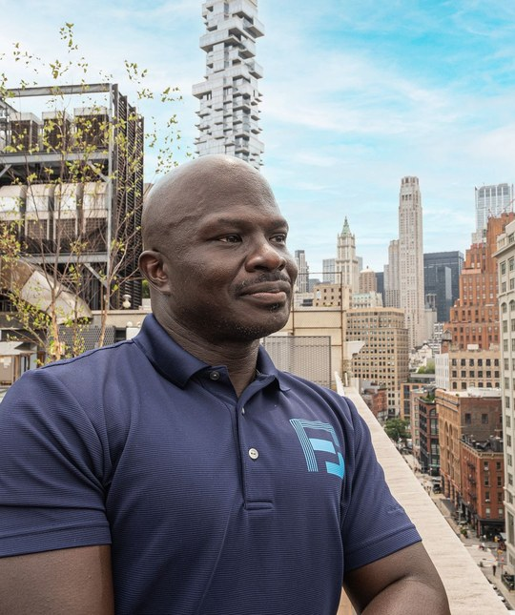

PROPRIETARY TECHNOLOGY PARTNER
Fulcrum Performance Labs — IP & Data Layer
Dr. Morris embeds Fulcrum's patented technology into every RegenHealth location — creating a clinical moat no competitor can replicate.
NovaKey™ + SSBreath™ — The Morris Method™
Two-platform performance intelligence OS. NovaKey™ aggregates biometric data (HRV, cortisol, sleep, lab results) into AI-driven daily guidance. SSBreath™ delivers real-time nervous system regulation — precision breath protocols that shift physiological state on command. No wearable required. IRB-validated. Embedded at every WFG location.
Co-Location Model · $200K Allocated
$200,000 allocation enables Fulcrum to open combined RegenHealth–Fulcrum locations across target markets and deploy joint marketing. RegenHealth can also open satellite clinics within Fulcrum's existing NYC, Lee NJ, and Dominican Republic facilities.
RegenHealth Physicians · Wellness Franchise Group
Elite Pro Sports Background · Protocols proven on professional athletes
Confidential · April 2026

Slide 9
MARKET OPPORTUNITY
$1.8 Trillion Global Wellness Market
Regenerative medicine growing to $132B by 2030 · RegenHealth at the intersection of all three sectors
01
02
03
Regenerative Medicine
Med Spa & Aesthetics
Longevity & Optimization
$38B → $132B by 2030
$19B U.S. · +12% / yr
$27B Recovery tech by 2027
— Hair restoration: $12B U.S. market
— Adults 40+ fastest-growing buyer
— Post-COVID demand surge
— Stem cell & exosome market exploding
— Avg ticket: $500–$2,500 / visit
— 90%+ cash-pay — no insurance
— High repeat-visit frequency
— Fastest-growing category
— Sexual wellness: $40B+ globally
— C-suite + high-performer ICP
— Peptide & IV therapy exploding
— Membership model emerging
RegenHealth Physicians · Wellness Franchise Group
Confidential · April 2026

Slide 10
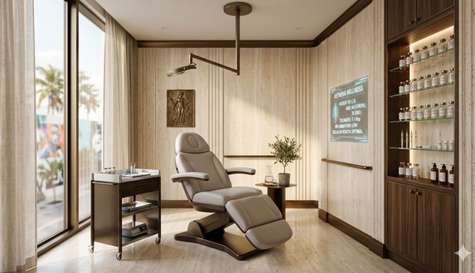

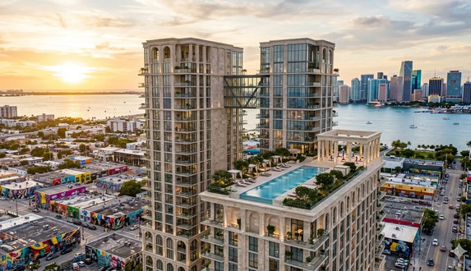
TIERED LOCATION MODEL
Three Tiers — Maximum Market Penetration
01
02
03
SATELLITE CLINIC
REGEN WELLNESS CENTER
AETHERA INSTITUTE
~1,000 sq ft · RegenHealth Physicians
3,500–4,000 sq ft · Regen Wellness Center + RegenHealth
163,000 sq ft · Aethera Wellness Institute
— $1.5M – 2.5M revenue / yr
— Lowest CapEx to open
— 6–8% franchise royalty
— Fastest to replicate
— Medical buildings · Hotels · Gyms
— $2M – 4M revenue / yr
— Membership + clinical revenue
— Dual-brand power
— Higher LTV per member
— Standalone · Hotel · Gym conversion
— $4M – 15M+ revenue / yr
— Highest brand valuation
— Institutional LP model
— Destination + franchise
— Resort · Hotel conversion
RegenHealth Physicians · Wellness Franchise Group
Confidential · April 2026

Slide 11
FRANCHISE & LICENSING STRATEGY
Launch + franchise simultaneously
Franchise & Licensing Strategy
How It Works
Unit Economics
— Turn-key clinic-in-a-box — full training & supply chain
— MSO Licensing — clinical layer in physician-owned states
— Royalties — 6–8% of gross revenue per franchisee
— Pooled marketing fund + GHL CRM tech stack
Revenue / clinic:
$1.5M – $4M / year
EBITDA margin:
25 – 40%
Initial franchise fee:
$50K – $75K
Expansion Targets
NYC 2nd Location
Nashville
Austin
Ongoing royalty:
6–8% gross revenue
Miami
Sacramento
National Rollout
Target (5yr):
50+ clinics nationally
Franchisor EBITDA (5yr):
$25M+ potential
RegenHealth Physicians · Wellness Franchise Group
Confidential · April 2026

Slide 12
WELLNESS CENTER LICENSING
Embedded Operating Partner — Not a Tenant
RegenHealth enters wellness centers as a full operating partner — we bring the clinical program, they provide the space.
What RegenHealth Brings
What the Partner Gets
— Full clinical program — stem cells, PRP, exosomes, IV peptides, aesthetics, hair
— Physician oversight + credentialed medical staff
— Proven protocols + patient journey playbook
— CRM, scheduling + patient follow-up technology
— Co-branded marketing + patient acquisition support
— Revenue share on all clinical services
— Zero hiring, credentialing, or clinical management
— Turn-key — RegenHealth runs the entire clinical division
— Premium physician-led brand positioning
— Higher member LTV — wellness clients become regen patients
Fitness & Health Clubs
Med Spas
Luxury Hotels
Corporate Wellness
Chiro & PT Clinics
Concierge Medical
RegenHealth Physicians · Wellness Franchise Group
Confidential · April 2026

Slide 13
FUTURE VISION
Integrated Wellness Centers
Regen medicine is the core. Integrated wellness becomes the growth engine — amplifying distribution and adding recurring revenue.
Today — RegenHealth Core
Future — Regen Wellness Center
Aethera Institute — Tier 3
— Physician-led regenerative medicine clinics
— NYC + SLC — 2 live, profitable locations
— Franchise/licensing pipeline launching now
— Cash-pay, high-ticket, high-margin
— Protocol-driven, replicable model
— Fitness + regen + wellness under one roof
— Lower CAC via ecosystem cross-sell
— Higher LTV — members become clinical patients
— Membership revenue augments high-ticket procedures
— Tier 2 rollout alongside franchise expansion
— 163,000 sq ft full-scale wellness hotel
— Flagship Wynwood Miami development
— Institutional LP model — $4M–$15M+ revenue
— Destination medicine + global brand
— Series A scope — $50M target raise
RegenHealth Physicians · Wellness Franchise Group
Confidential · April 2026

Slide 14
FINANCIAL PROJECTIONS & USE OF PROCEEDS
5-Year Model · Conservative Estimates
5-Year Model
Revenue
EBITDA
$52M
$52M+
Yr 5 Revenue
$28M
$21M
$12M
Yr 5 EBITDA
$6M
$3M
$100–180M
Yr 1
Yr 2
Yr 3
Yr 4
Yr 5
Yr 5 Valuation
USE OF PROCEEDS — $3,250,000
01 OPERATIONS / WORKING CAPITAL
02 CLINICAL EXPANSION
03 FRANCHISE LAUNCH
$1,000,000
$1,250,000
$1,000,000
Marketing $450K · Exec comp $350K · Legal $200K
NYC 2nd location · Equipment · Tech platform · USMLE100 IRB $50K
FDD filing · Physician training · BD · Fulcrum co-locations $200K
RegenHealth Physicians · Wellness Franchise Group
Confidential · April 2026

Slide 15
POST-RAISE MILESTONES
12-Month Roadmap
Q2 2026
Q3 2026
Q4 2026
Q1 2027
FOUNDATION
LAUNCH
SCALE
MOMENTUM
0–90 days
90–180 days
180–270 days
270–365 days
— 506(b) + 506(c) raise closes
— Legal + compliance finalized
— FDD filed
— $3.25M fully deployed
— NYC 2nd location opens
— Franchise sales begin
— Tech platform live
— Physician training program
— First franchise signed
— Nashville + Austin expansion
— Memberships launched
— $500K+/month revenue target
— 5+ franchise commitments
— Valuation re-rate
— IPO / reverse merger prep
— $2M+/month run rate
Capital deployed with discipline. Every dollar tied to a revenue-generating milestone.
RegenHealth Physicians · Wellness Franchise Group
Confidential · April 2026

Slide 16

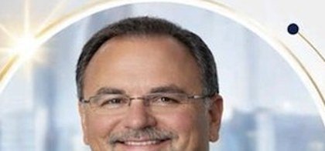
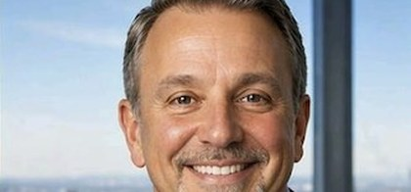

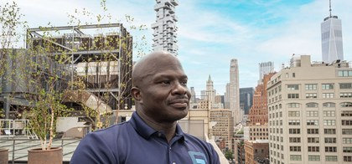
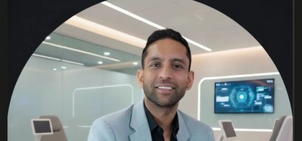
LEADERSHIP TEAM
Physician-led · Operator-executed · Performance-science driven
The Team
Dr. Ajit Dhaliwal, MD
James Zimbler
Vincent Butta
Dr. Ravneet Dhaliwal
Founder & Chief Medical Officer
Chief Executive Officer
Chief Operating Officer
Clinical Director & Partner
AK
Dr. Morris
Dr. Ali Khan, MD
Jaye Patel
Clinical Director, Elite Human Performance
Clinical Director, Research & Medical Training
Director of Business Development
Fulcrum · NovaKey™ + SSBreath™ IP
USMLE100 — Founder
RegenHealth Physicians · Wellness Franchise Group
Confidential · April 2026

Slide 17

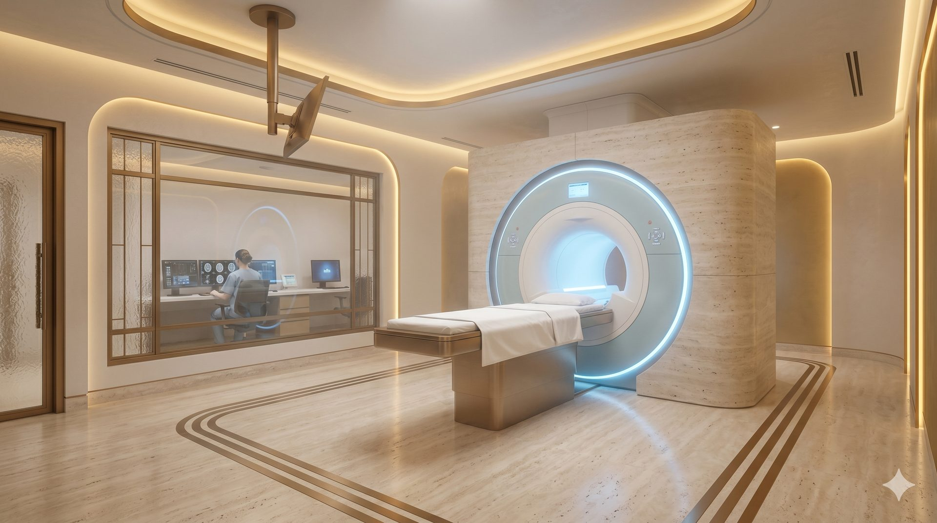
PARTNERS & AFFILIATIONS
Institutional relationships that validate the platform
Partners & Affiliations
Fulcrum Performance Labs
SelfHealth.health
Pro Football Legends
JIV — Just IV
NovaKey™ + SSBreath™ — The Morris Method™ · Patented performance OS · IRB-validated protocols
On-site clinical testing at every WFG & USMLE100 location · ~40% margin revenue stream · Integrated into IRB protocols
Partner affiliation · Clinical protocols for retired pro athletes · Dr. Morris — former NFL Alumni Performance Lab CEO
Joint venture partner · Integrated wellness center co-location model
Dr. Ali Khan, MD — Founder · 600+ physicians trained · IRB governance & clinical protocol development · SelfHealth.health on-site testing integrated across all WFG + USMLE100 locations · Research published alongside SpaceX team
USMLE100
RegenHealth Physicians · Wellness Franchise Group
Confidential · April 2026

Slide 18
EXIT STRATEGY
Multiple Clear Paths to Liquidity
Private Equity Acquisition
Strategic Buyer
Healthcare PE funds seeking platform roll-up
Wellness platform, med spa consolidator, franchise group
Wellness & longevity platforms · Med spa consolidators
Fitness franchise groups · Healthcare private equity
Public Market
Revenue Recapitalization
Reverse merger or direct IPO — multiple expansion + liquidity
Refinance at higher valuation, return capital, retain control
Sovereign wealth funds · Strategic pharma / biotech
Institutional family offices · Long-term equity holds
Yr 1–2: Build · Yr 3: Franchise · Yr 4: IPO prep · Yr 5: Exit / Recapitalization
RegenHealth Physicians · Wellness Franchise Group
Confidential · April 2026

Slide 19
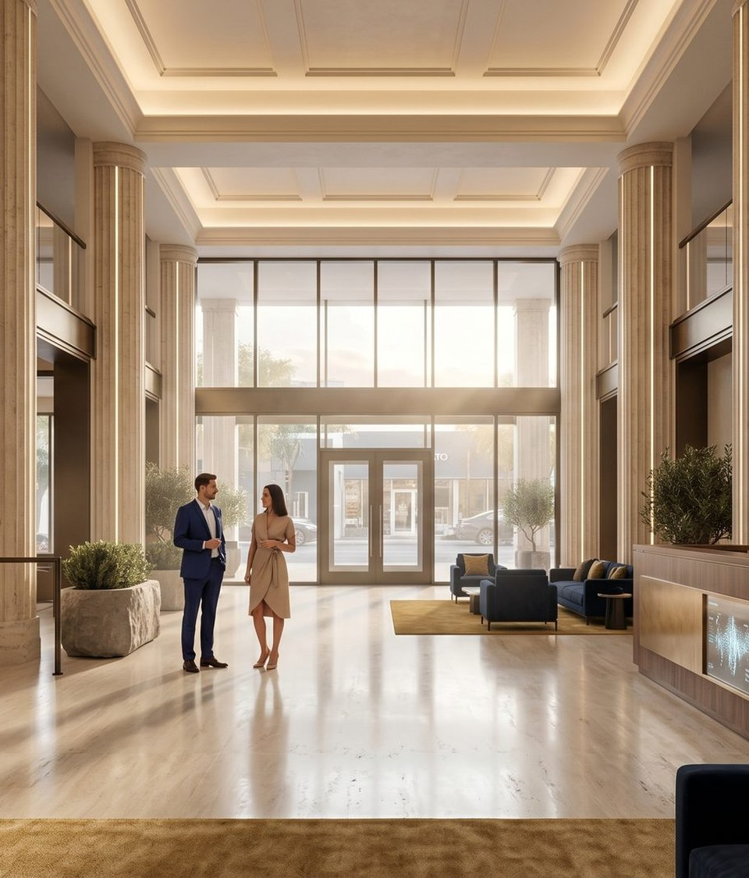
FINAL INVESTMENT NARRATIVE
Why This Wins
RegenHealth is NOT:
First integrated regen medicine + longevity platform — corporate + franchise launched simultaneously
— A typical med spa chain
— An insurance-dependent clinic
— A gym or fitness brand
— A single-location operation
96% gross margin · 25–40% EBITDA per clinic · High-ticket recurring revenue
Fulcrum Performance Labs — patented remote vital monitoring IP — no competitor can match
It Is:
A scalable, physician-led, multi-revenue healthcare platform
built for national markets and institutional capital.
Operating today. Proven unit economics. Ready to scale.
Asset-light franchise/MSO model — physician-led brand credibility that can't be replicated
Public market upside — reverse merger path + institutional capital ready
James Zimbler, CEO · Jaye Patel, Dir. of Business Development · Dr. Ajit Dhaliwal, MD — CMO
rhpny.com · wellnessfranchisegroup.com

